Slide 1
AP Language & Composition
Mrs. McDermott

Slide 2
Welcome!
http://www.youtube.com/watch?v=x78PnPd-V-A

Slide 3
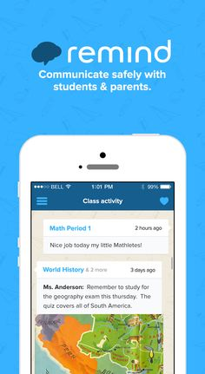
REMIND.COM
Text your class code to 81010
Period 3 – @mcdgjap3
Period 5 - @mcdgjap5
Period 6 - @mcdgjap6
Period 7 - @mcdgjap7

Slide 4
Rules
https://www.youtube.com/watch?v=ddvTFgzkS5M

Slide 5
Course Objectives a la College Board
Critically read texts from several disciplines and time periods to see how an author produces an effect on a particular audience.
Write texts in which you accomplish your purposes for a specific audience.
Develop research skills that allow you to evaluate sources, both primary and secondary, and synthesize key information from them in order to support your researched argument, complete with citations, in MLA (Modern Language Association) format.

Slide 6
Course Objectives a la McD
If you want a 3 on your AP Exam:
Learn, apply, and display mastery of all the rules/guidelines of formal writing. (I can teach you this.)
If you want a 4 or 5 on your AP Exam:
Learn, apply, and display mastery of all the rules/guidelines of formal writing.
Transcend the rules. Break a few for effect. (This is entirely up to you.)

Slide 7
Course Expectations
Come to class prepared with books, supplies and homework, ready to work
Thoughtful and completed reading and writing assignments
Work that is word-processed, on time, and professionally presented (when it goes home and others will read it), or neatly written in blue or black ink for in-class writing
Courtesy and attentive listening in discussions so everyone’s opinion can be heard and valued
Manage your course materials. If you lose yours, borrow a classmate’s for photocopying

Slide 8
Course Expectations
Manage your time and your assignments. You can expect to have some type of homework every night, including weekends. Assignments are due at the start of class. If you need and deserve an extension on an assignment, see me or email me BEFORE the due date to negotiate a possible extension. No deals on the date an assignment becomes due. Keep up with your grades on the internet and contact me promptly if there are any discrepancies.
A good attitude and an open mind
Generous intellectual contribution to all group work
Honesty and integrity in all class transactions
Ask for help or clarification with course work objectives whenever necessary

Slide 9
Contact Information
Email – rebecca.mcdermott@polk-fl.net
Website - http://mcdjediwriting.weebly.com/
Email is the BEST way to reach me. Emails come straight to my phone.
Please don’t traumatize me with terrible grammar if you choose to email me.
Actual Email: Yo McD! What was the homework you gave in class while I was not paying attention because I sit next to a very pretty girl. That is all. John

Slide 10
Major Units
Rhetorical Devices/Analysis
Argument/Persuasive Writing
Synthesis/Research
Multiple Choice/Test Taking Strategies
College Essay Writing

Slide 11
Materials Needed

Slide 12
Materials Needed
Blue or black pen (no writing in rainbow colors)
Pencil
A folder (you choose the type) – it must be a place where you keep your English work ONLY!
Notebook Paper
2 spiral notebooks (70 pages/college ruled)
Index cards (4 x 6)
1 ream of copy paper

Slide 13
Major Works Studied
The Crucible (Miller)
“A Modest Proposal” (Swift)
1984 (Orwell)
The Catcher in the Rye (Salinger)
The Things They Carried (O’Brien)
The Great Gatsby (Fitzgerald)
Of Mice and Men (Steinbeck)
The Chosen (Potok)

Slide 14
Absences

Slide 15
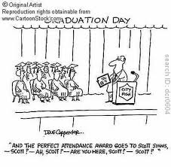
Absences
Most PowerPoints/notes will be on my website. Ask a classmate what we did, email me, or come see me BEFORE OR AFTER SCHOOL!
Having a pre-excused absence means
turning in papers and taking announced
tests BEFORE the absence and being
prepared for class the day you return.
If you are in the CHOICE room during
my class period, see me THAT afternoon
to turn in the assignment that was due
that day.

Slide 16
Absences
ALL AP English Students at GJ will follow the more stringent POLK COUNTY ATTENDANCE POLICY – If you have more than three unexcused absences PER SEMESTER (not per quarter), you will be unable to make up assignments/tests you miss on future UNEXCUSED absences for ANY CREDIT.
If you are sick, stay home. But, PLEASE, get the absence EXCUSED!

Slide 17
In/Out Box

Slide 18
In/Out Box
Turn work in to your class “in” folder in the back of the room.
Once work is graded, it will be in your class “out” folder. It is your responsibility to get the work. Contents of out folders will be thrown out at the end of each month.
There is a “no name” folder in the outbox. Any work turned in without a name will be placed in it.

Slide 19
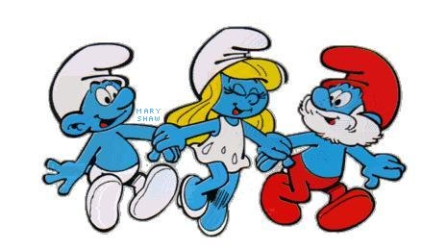
Bellwork
Bellwork should be started when you enter my classroom.
It will be collected twice a quarter.
As long as it is complete, you will earn full credit on it.

Slide 20
Test Days
Wear an orange or blue shirt – or both for extra credit (equivalent to one question only)—I will not count your nails, bracelet, shoes, socks, or boxers.
No talking until the last test is turned in.
Keep your genius to yourself!

Slide 21
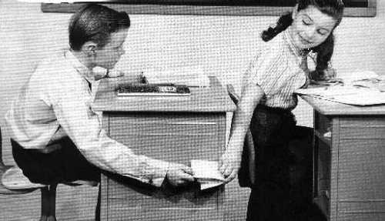
Notes
I reserve the right to evaluate any note I intercept for grammatical correctness and level of “juiciness”
It is highly likely that I will grade and then post your note for others to see.
Don’t pass notes in class.

Slide 22
Cell Phone Policy
Unless we are working on research, playing a Kahoot, or I have specifically given you permission to use your cell phone for educational purposes, it needs to be in the envelope and in the basket under your desk per school policy.
**You are NOT allowed to charge your cell phones in the classrooms at GJHS.

Slide 23
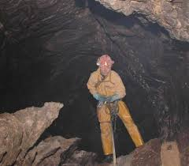
.4 Club
This is not a club you want to join.

Slide 24
Your “one” (for the whole year)

Slide 25
Your “one” (for the whole year)

Slide 26
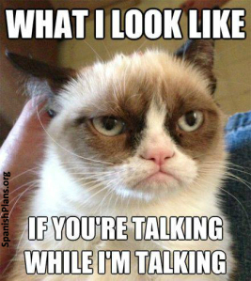
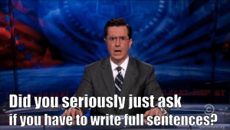
Taboos

Slide 27
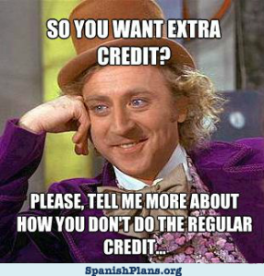
Taboos

Slide 28
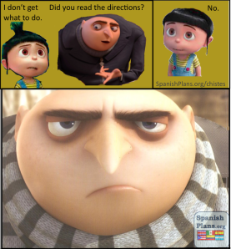
Taboos

Slide 29
Taboos
https://www.youtube.com/watch?v=8Gv0H-vPoDc
Review Taboos

Slide 30
Vocabulary
Word List
THREE 20 word lists per quarter.
Quizzes are CUMULATIVE.
Each quarter will end with a TEST of all three units.
Put the words/definitions in your long-term memory!

Slide 31
Letters
Former AP Lang students
Read and Share

Slide 32
“Words – so innocent and powerless as
they are, as standing in a dictionary, how
potent for good and evil they become in
the hands of one who knows how to
combine them.”
-Nathaniel Hawthorne

Slide 33
"Words are, in my not-so-humble
opinion, our most inexhaustible source of
magic. Capable of both inflicting injury,
and remedying it."
-Professor Albus Dumbledore (J.K. Rowling)

Slide 34
Power of Words
http://www.youtube.com/watch?v=Wgi0t2ap-us&feature=youtu.be
How Authors Create Meaning (Rhetorical Devices) - Handout

Slide 35
What NOT to do:
25 Unintentionally Funny Analogies
by High School Students

Slide 36
Assignment
Relationship to Writing Paper - due NEXT class

Slide 37
3 Statements
Write 3 statements about yourself. 2 should be
true. 1 should be false. Be creative and
convincing. Your lie should not be obvious.
The class will listen to your statements and
attempt to determine which one is the lie.
I have been to 8 countries.
My husband is not American.
The Notebook is a beautiful tale of love and loss that doesn’t make me want to spew chunks. It isn’t cheesy at all. I didn’t cry tears of joy when it finally ended and tears of loss for the two hours of my life I will never get back.

Slide 38
Index Card (Front)
Last Name, First Name Class Period
10th grade English teacher
Parent Name – Parent Email – Contact Number
Favorite Novel
Clubs, Hobbies, Sports, Job, etc?

Slide 39
Index Card (back)
Things you liked about 10th grade English:
1.
2.
3.
Things you didn’t like about 10th grade English:
1.
2.
3.

