Slide 1
Creative Writing
Mrs. McDermott

Slide 2
Welcome!
http://www.youtube.com/watch?v=x78PnPd-V-A

Slide 3
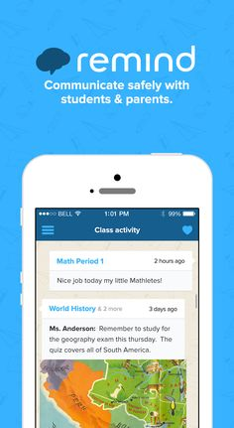
REMIND.COM
Text your class code to 81010
Period 1 – @mcdcw1
Period 2 - @mcdcw2

Slide 4
Rules
https://www.youtube.com/watch?v=ddvTFgzkS5M

Slide 5
Rules
All Polk County/George Jenkins rules and policies (cell phones, tardiness, absences, etc.) will be followed.

Slide 6
Course Objectives
Students will be expected to enter final products into professional and/or student contests as well as the school’s literary magazine, to conference with the instructor, participate in writer response groups, research and read contemporary published authors, keep and regularly write in a writer’s notebook, and experiment with and revise writing routinely.

Slide 7
Course Expectations
Come to class prepared with books, supplies and homework, ready to work
Thoughtful and completed assignments
Work that is word-processed, on time, and professionally presented (when it goes home and others will read it), or neatly written in blue or black ink for in-class writing
Courtesy and attentive listening in discussions so everyone’s opinion can be heard and valued
Manage your course materials. If you lose yours, borrow a classmate’s for photocopying

Slide 8
Course Expectations
A good attitude and an open mind
Generous intellectual contribution to all group work
Honesty and integrity in all class transactions
Ask for help or clarification with course work objectives whenever necessary

Slide 9
Contact Information
Email – rebecca.mcdermott@polk-fl.net
Website - http://mcdjediwriting.weebly.com/
Email is the BEST way to reach me. Emails come straight to my phone.
Please don’t traumatize me with terrible grammar if you choose to email me.
Actual Email: Yo McD! What was the homework you gave in class while I was not paying attention because I sit next to a very pretty girl. That is all. John

Slide 10
Major Units
Basics of Writing/Toolbox - common grammatical mistakes, writing skills, usage, plagiarism workshop, Feedback – Editing Workshop,
Fiction- Elements of Short Fiction (plot, character, setting, conflict, dialogue), Fractured Fairy Tale, Character Development, Conflict, Setting, Children’s Book, Scary Story
Creative Non-Fiction – Elements of Non-Fiction, Personal Narrative, Letters of gratitude
Poetry – Poetry Portfolio, Literary Magazine, Submission of work for publication
Drama – Elements of Drama, Read One Act Plays, Writing and performing an original play

Slide 11
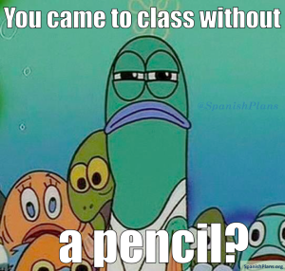
Materials Needed

Slide 12
Materials Needed
4 one subject spiral notebooks (one for each quarter – these can usually be purchased for $.25 each during Back to School Sales)
Black or blue pen
Color Pen (green, red, or purple) for editing
Folder (I do not care what kind – it does not have to be a binder; it must be a place for your Creative Writing work only)
College Ruled Notebook Paper
Flash Drive
One box of tissues – you will be glad you donated when cold season arrives

Slide 13
Absences

Slide 14
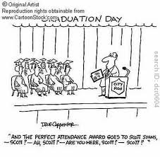
Absences
If you have a question about make up work, come see me BEFORE OR AFTER SCHOOL!
Having a pre-excused absence means
turning in papers and taking announced
tests BEFORE the absence and being
prepared for class the day you return.
If you are in the CHOICE room during
my class period, see me THAT afternoon
to turn in the assignment that was due
that day.

Slide 15
Absences
Attendance is a form of participation. A writing community cannot thrive without each member being present. Students who miss class due to an excused absence may not be able to complete a class assignment since some activities can only be completed within the class setting; however, such an assignment will NOT detract from a student’s grade.
If you are sick, stay home. But, PLEASE, get the absence EXCUSED!

Slide 16
In/Out Box

Slide 17
In/Out Box
Turn work in to your class “in” folder in the back of the room.
Once work is graded, it will be in your class “out” folder. It is your responsibility to get the work. Contents of out folders will be thrown out at the end of each month.
There is a “no name” folder in the outbox. Any work turned in without a name will be placed in it.

Slide 18
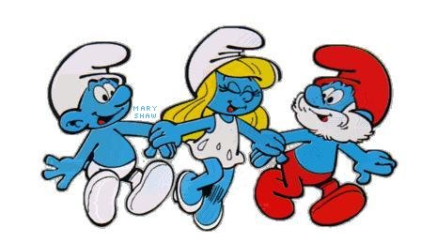
Journal
The purpose of the journal is to give you the opportunity to write every day. It is a place for you to write and create –don’t worry about spelling, grammar, or flow. Just write. Sometimes you will free-write in your journals while other days you will respond to a provided prompt. I just want you to write! Journals will be collected periodically as a means of accountability. I will let you know in advance when they will be collected.

Slide 19
Alert Writing
Alert Writing: While one of the fundamental goals of this class is for students to use their unique experiences, aspirations, and inspirations for writing creatively, students should understand that their writing will be read by others. Since all students’ well-being is an utmost priority, any “alert” writing will be investigated (shared with the proper authorities, counselors, parents, etc.) to ensure that the student writer is physically, mentally, and emotionally safe. “Alert” writing is writing that contains depictions of any of the following:
Gratuitous violence, sex, language, or drug use
Harm to self or others
Physical, mental, emotional, or sexual abuse
Bullying

Slide 20
Test Days
Wear an orange or blue shirt – or both for extra credit (equivalent to one question only)—I will not count your nails, bracelet, shoes, socks, or boxers.
No talking until the last test is turned in.
Keep your genius to yourself!

Slide 21
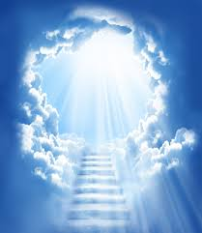
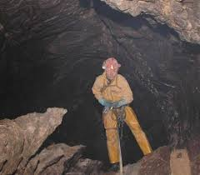
.4 Club
This is not a club you want to join.

Slide 22
Your “one” (for the whole year)

Slide 23
Your “one” (for the whole year)

Slide 24
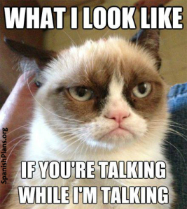
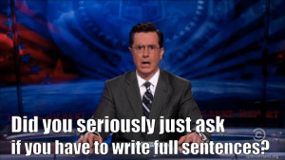
Taboos

Slide 25
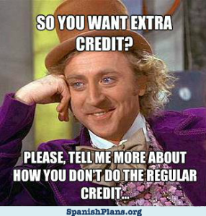
Taboos

Slide 26
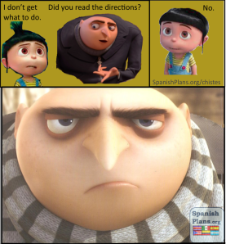
Taboos

Slide 27
“Words – so innocent and powerless as
they are, as standing in a dictionary, how
potent for good and evil they become in
the hands of one who knows how to
combine them.”
-Nathaniel Hawthorne

Slide 28
"Words are, in my not-so-humble
opinion, our most inexhaustible source of
magic. Capable of both inflicting injury,
and remedying it."
-Professor Albus Dumbledore (J.K. Rowling)

Slide 29
Literati
Definition:
1: the educated class; also : intelligentsia
2: persons interested in literature or the arts
https://www.merriamwebster.com/dictionary/literati

Slide 30
Assignment
Tell me about your favorite book. What is the title? Who wrote it? What genre is it? What makes it so good? Be prepared to share your answer next class period.
This should be no longer than 200 words.
Either type this or write it in your neatest handwriting (black or blue ink).

Slide 31
3 Statements
Write 3 statements about yourself. 2 should be
true. 1 should be false. Be creative and
convincing. Your lie should not be obvious.
The class will listen to your statements and
attempt to determine which one is the lie.
I have been to 8 countries.
My husband is not American.
The Notebook is a beautiful tale of love and loss that doesn’t make me want to spew chunks. It isn’t cheesy at all. I didn’t cry tears of joy when it finally ended and tears of loss for the two hours of my life I will never get back.

Slide 32
Index Card
Last Name, First Name Class Period
Parent Name
Parent Email
Contact Number
Clubs, Hobbies, Sports, Job, etc?

